Slide 1
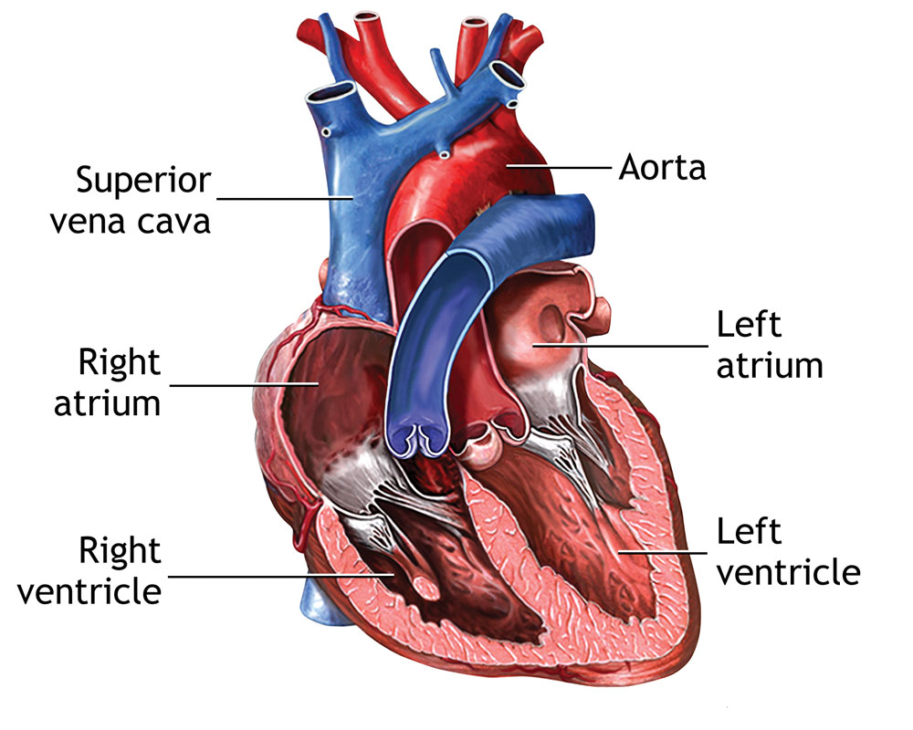
THE HEART
By AV, AD, AA and GD - 2B

Slide 2
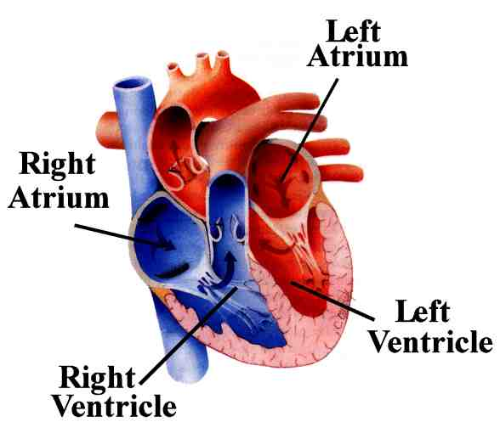
The heart pumps blood to the lungs and other parts of the body. It is made of cardiac muscle, which is a special type of muscle that does not fatigue easily.
There are four chambers inside the heart: right atrium, left atrium, right ventricle, left ventricle.

Slide 3
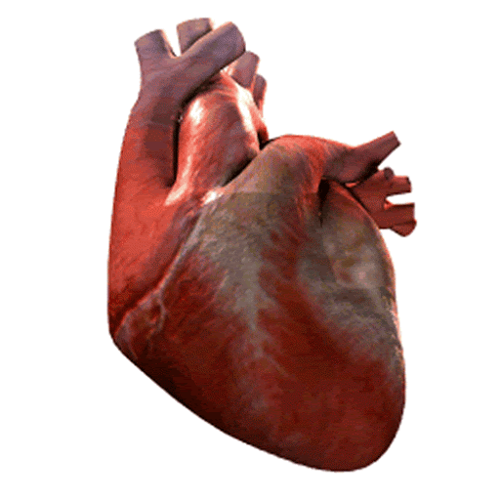
Cardiac muscle
Cardiac muscle allows the heart to continuously contract. When the heart contracts, blood is forced out of the heart. When it relaxes the heart fills with blood. Blood enters heart through left and right atrium. Blood leaves the heart through the left and right ventricles.

Slide 4
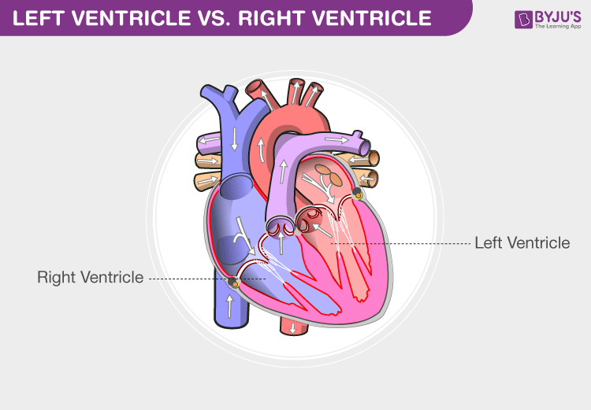
Left ventricle and right ventricle
The left ventricle is larger than the right ventricle because blood is pumped to the whole body from the left ventricle whereas the right ventricle only pumps blood to the lungs. Valves are composed of connective tissue and control the flow of blood through the heart.

Slide 5
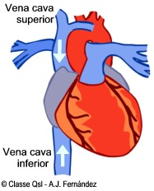
Superior and inferior vena cava
The superior vena cava carries oxygen-poor blood from the head and upper limbs. The inferior vena cava carries oxygen-poor blood from the abdomen and lower limbs. The deoxygenated blood enters the right atrium of the heart.

Slide 6
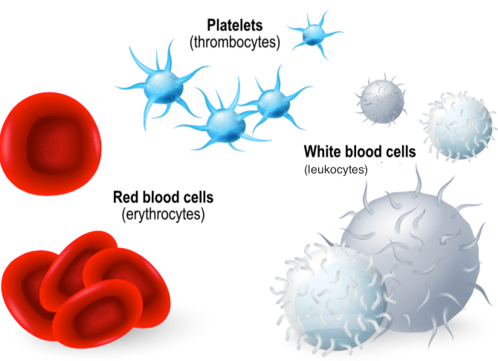
CURIOSITY
Red blood cells (called erythrocytes) are cells made up of blood. They have a biconcave shape, red color, and in mammals they do not have the nucleus. Red blood cells are produced by bone marrow.
White blood cells (called leukocytes) are blood cells. They are larger cells than red blood cells, they have a nucleus. White blood cells are produced in the bone marrow.
Platelets (called thrombocytes) are fragments of blood cells without nucleus that are produced by the bone marrow.

